Slide 1
COUNTRY REPORT
United Kingdom
Delegate - Gill Davies (Department for Energy Security & Net Zero)
Alt‘ Delegate - Dr. Jonathan Radcliffe (University of Birmingham)
ExCo 31 May/ 1 June 2023

Slide 2
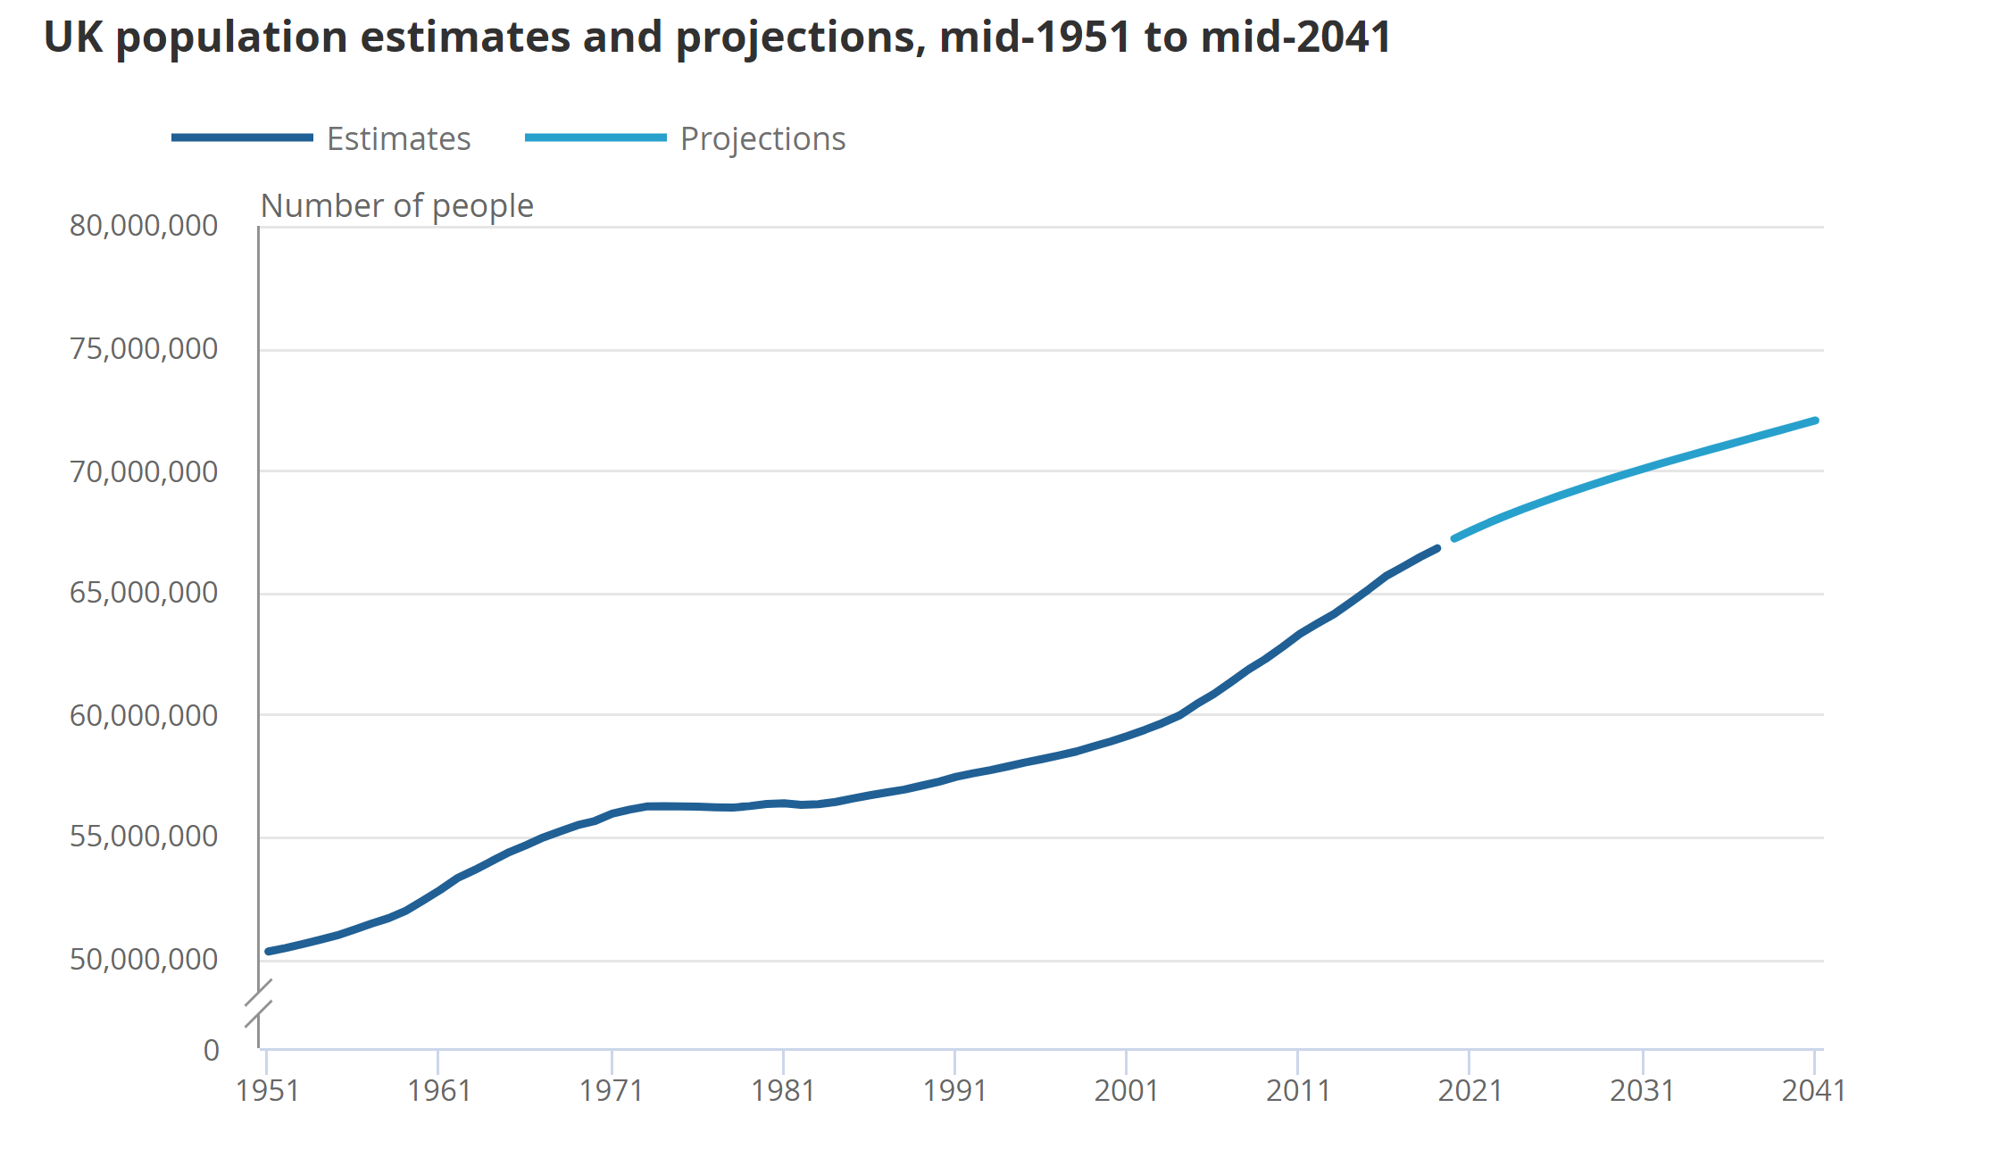
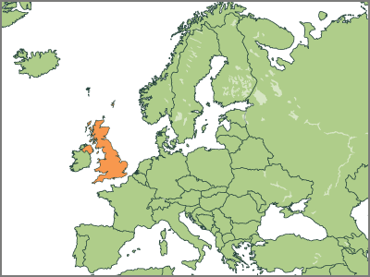
UK - Population & Demographic
UK population
Latest mid-year estimate (2020):
67,081,000
The United Kingdom consists of the countries of England, Wales, Scotland and Northern Ireland.
Reference: https://www.ons.gov.uk/peoplepopulationandcommunity/populationandmigration/populationestimates/articles/overviewoftheukpopulation/2020

Slide 3
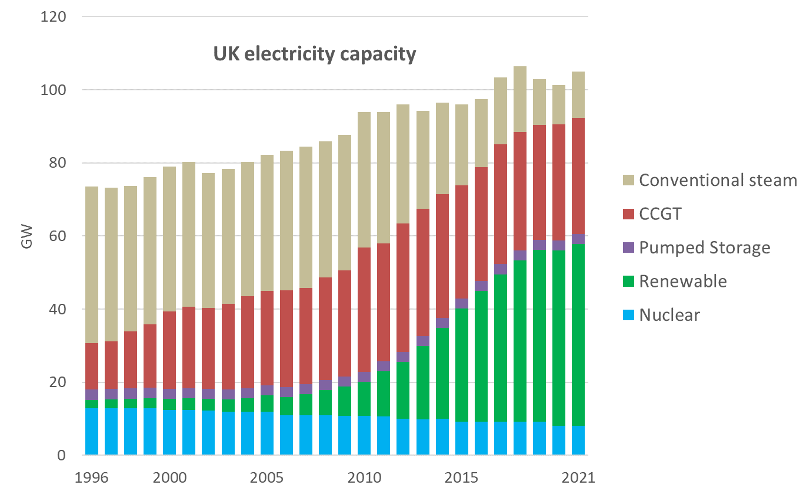
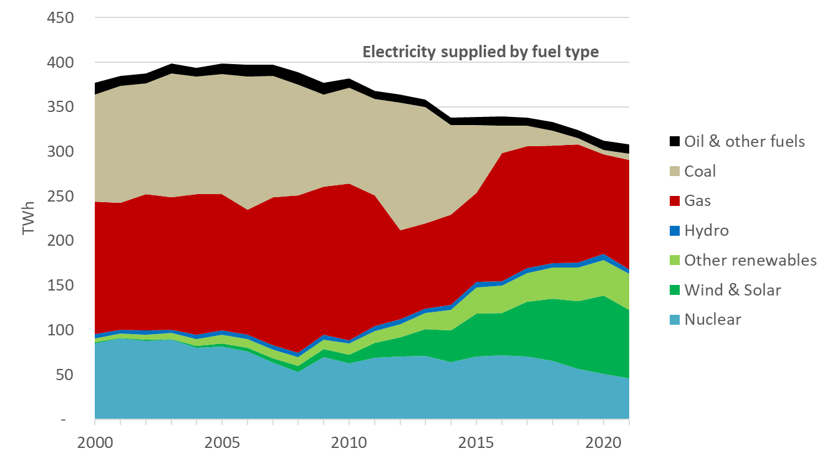
Country Specific Information
Installed capacity for electricity generation in the UK increased gradually between 1996 and 2018, from 73.6 GW to 101.2 GW. In 2019 and 2020, total capacity fell following the closure of several large coal-fired plants, and the mix of plants shifted towards renewable different technologies.
Reference: https://www.gov.uk/government/collections/uk-energy-in-brief (2022)

Slide 4
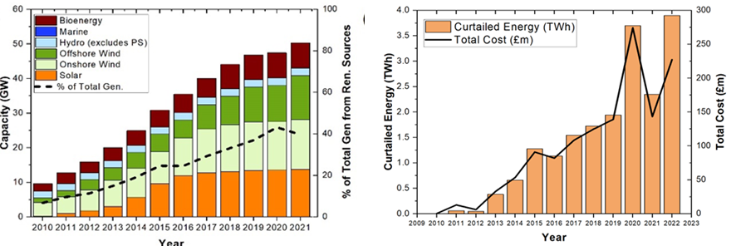
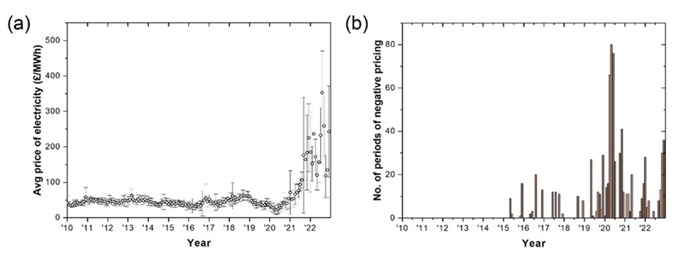
Electricity market adapting
Opportunities for storage opening up:
RES and curtailed energy increasing
Variability in market prices, and number of periods with negative price, also increasing.
Reference: UoB analysis from National Grid ESO

Slide 5
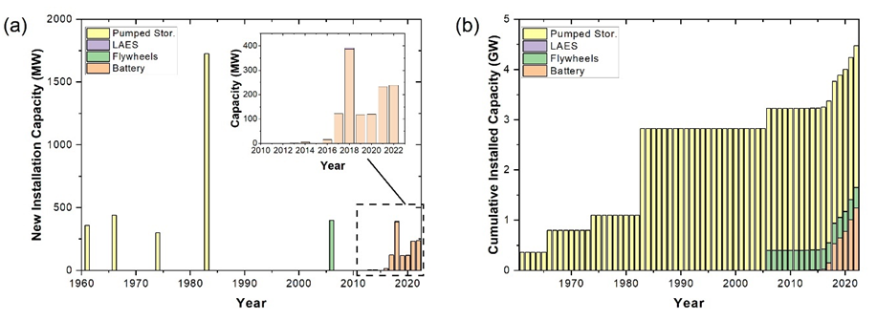
Energy Storage Landscape
Capacity
Today, there is around 4GW of electricity storage operational in Great Britain, made up of 3GW of pumped hydro storage and 1GW of lithium-ion battery storage that has been built since 2017.
Reference: Renewable Energy Planning Database, Department for Energy Security & Net Zero (https://www.gov.uk/government/publications/renewable-energy-planning-database-monthly-extract)

Slide 6
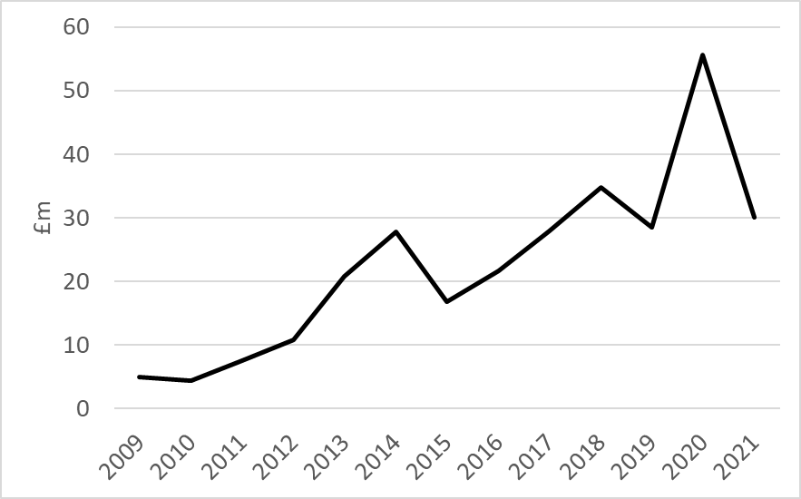
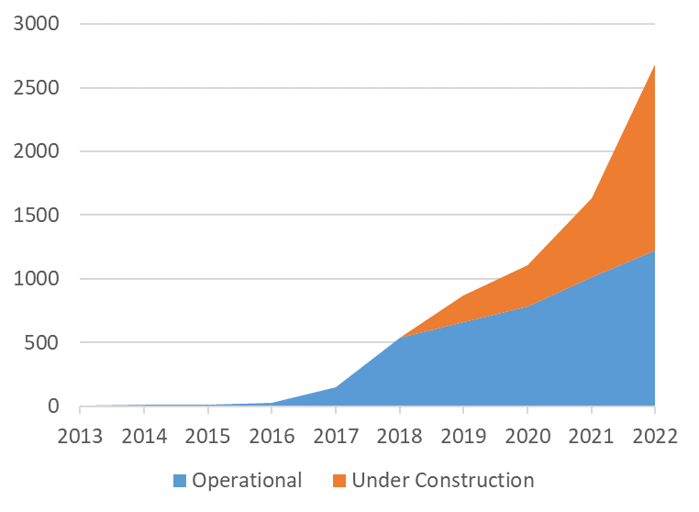
RDD: Innovation Support
Energy storage RD&D funding over the last 15 years from other sources: Energy Technologies Institute, Ofgem, Govt departments, Innovate UK (separating out EV specific projects)
New grid connected battery storage in the UK
Source: IEA statistics
Reference: UK Energy Storage Observatory https://ukesto.supergenstorage.org/

Slide 7
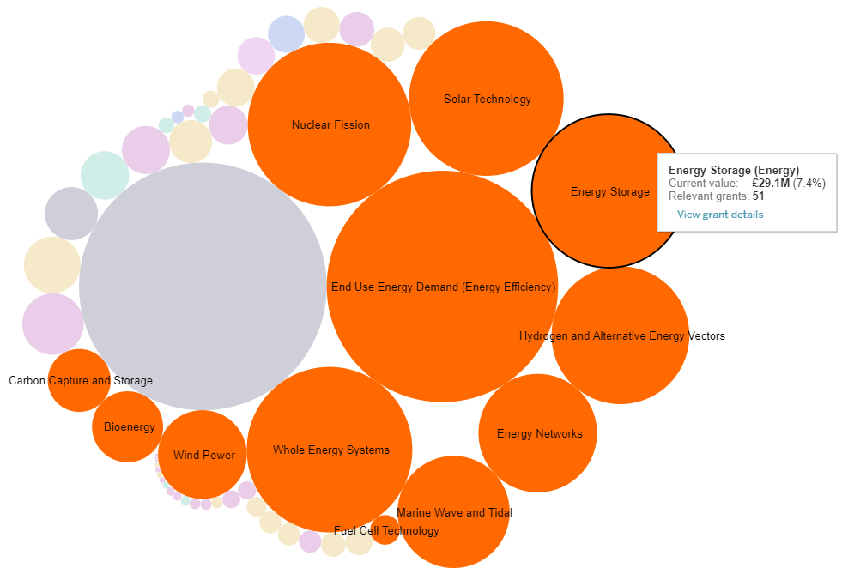
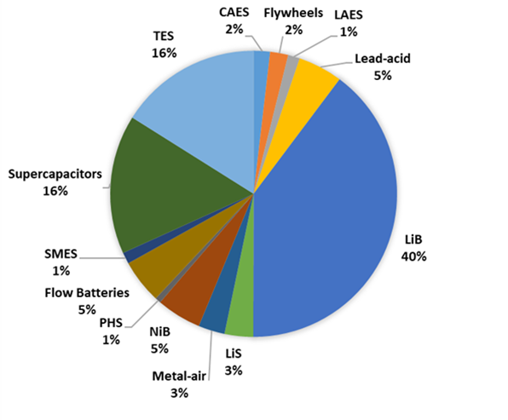
Energy Storage Research
Currently 51 research projects on energy storage, value £29m.
UK energy storage publications by technology, 2000-2020
UK Research Councils Energy and Decarbonisation portfolio https://public.tableau.com/app/profile/epsrcdatateam/viz/VisualisingourPortfolio/VoP
Reference: University of Birmingham analysis from Web of Science data

Slide 8
RDD: Government Innovation Support
Longer Duration Energy Storage Demonstration (LODES)
£69m funding for first-of-a-kind longer duration energy storage technologies
Now in Phase 2: 8 demonstrators in progress (5x electricity; 2x thermal; 1x power-to-x)
Completion by end of March 2025

Slide 9
Government Policies
Machinery of Government (MOG) change
Now Department for Energy Security & Net Zero
Secretary of State: Grant Shapps; Minister of State: Graham Stuart
Transition to a smarter, more flexible energy system, including:
Continue progress towards a best-in-class regulatory framework for storage
Facilitating the deployment of large-scale and long-duration storage
In the Powering up Britain: Energy Security Plan, we committed to putting in place an appropriate policy framework by 2024 to enable investment in large scale long duration electricity storage (LLES), with the goal of deploying sufficient storage capacity to balance the overall system.
We are currently undertaking the next phase of policy development to assess what policy approach is best suited to enable investment in LLES projects and anticipate that we will be consulting stakeholders on a policy approach this year.
Removing barriers and distortions to domestic and small-scale storage

Slide 10
UK Government Ambition
2021
2022
2023
2024
2030
2040
Up to 50GW of Offshore Wind by 2030
British Energy Security Strategy, April 2022
Up to 10GW of Hydrogen production by 2030
Develop appropriate policy to enable investment in long-duration energy storage
Up to 70GW of solar by 2035
Other
REMA implementation from mid-2020s to meet 2035 commitment
30GW* of flexibility required
Decarbonise electricity system by 2035

Slide 11
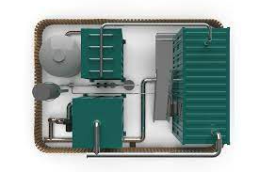
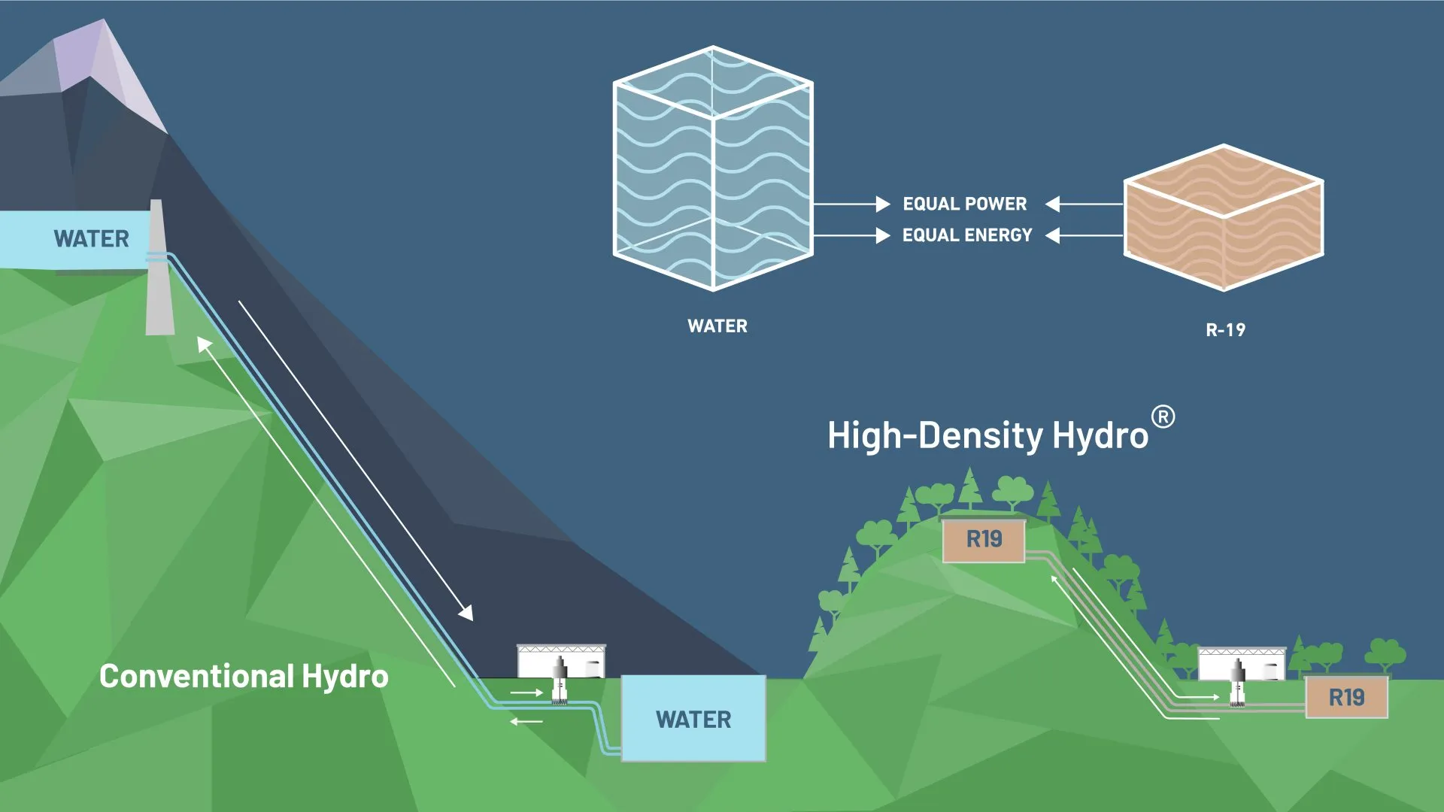
Case Studies: LODES Stream 2 Phase 2
RheEnergise – High-density® Hydro
£8,242,965
Closed loop pumped hydro system using environmentally benign fluid
2.5x denser than water
First-of-a-kind demonstrator in Devon
Cheesecake Energy - Flexitanker
£9,447,225
Combines compressed air energy storage (CAES) and thermal energy storage
Test unit at University of Nottingham; multiple systems in Colchester co-located with solar microgrid & district heat network

Slide 12
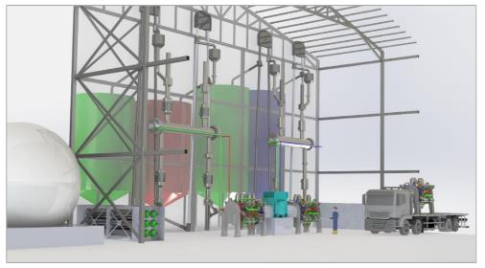
Case Studies: LODES Stream 2 Phase 2
SynchroStor - Pumped Thermal Energy Storage (PTES) Demonstrator
£9,439,302
Patented PTES technology
Electricity to heat, stored in low-cost, non-toxic sustainable materials
Reverses process to generate electricity when required
Grid-connected 1MW demonstrator with 10 hours of storage
IEA ES TCP Newsletter Dec 2022 case studies:
Sunamp Ltd. – Extend
EDF R&D UK – HyDUS
StorTera – SLIQ
Final 2 LODES projects:
University of Sheffield – ADsoRB
Invinity - (Stream 1) – VFB LEAD

Slide 13
Other Relevant Information
UK Government Publications
Smart System and Flexibility Plan, July 2021 (BEIS and Ofgem)
Net Zero Strategy: Build Back Greener, Oct 2021
British Energy Security Strategy, April 2022
Powering Up Britain: Energy Security Plan, March 2023
Longer Duration Energy Storage Demonstration: Successful Projects
Events
Thurs 29th June: UK National Team meeting followed by Task 42 meeting
Sept 11th: Next Supergen Energy Storage Network+ annual meeting, Imperial College

Slide 14
The Energy Storage TCP
Country reports are an informative contribution of the ExCo delegates of the ES TCP member countries.
Views, findings, and publications of the ES TCP do not necessarily represent the views or policies of the IEA Secretariat or its individual member countries.

